Slide 1
Task 5
6/30/2023

Slide 2
Pose evaluation
Visual clustering
Audio Process & clustering

Slide 3
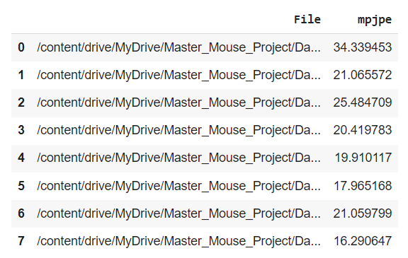
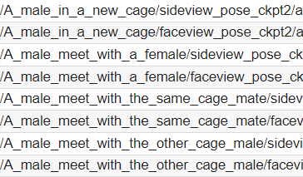
1. Pose evaluation
Updated
pose_evaluation.ipynb
mpjpe_evaluation.json

Slide 4
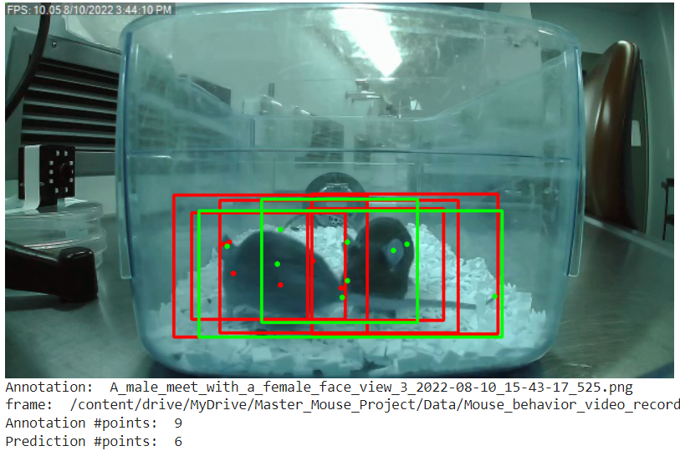
GT Annotation
Prediction

Slide 5
Visualization Conclusions
Conclusions
#annotation_points != #pred_points
points only for 1 mouse
bounding boxes detect both mice

Slide 6
2. Visual clustering
New approaches
Adding more points to the data
Not just “box”
Adding “keypoints”
From 4 to 16 features
Concatenate consecutive frames
Use 20 consecutive frames as one single input
Better clustering
Shows “movement”

Slide 7
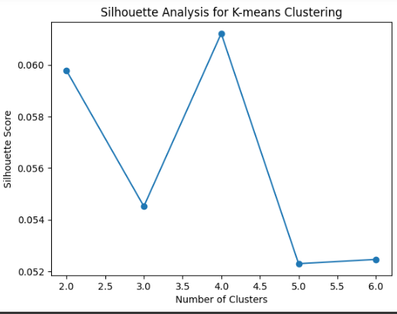
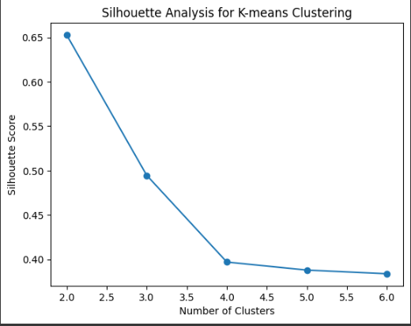
2. Visual clustering
Results
Most valuable insight: larger number of clusters

Slide 8
2. Visual clustering
Problems found
Not clear which points correspond to each part of the mouse
Not sure which file select (newest)
The optimal number of clusters revealed by the elbow method does not increase (2)
If consecutive frames selected, the number of rows decrease a lot (underfitting risk)

Slide 9
2. Visual clustering
Possible future paths
Identify which point represent to each part
Try to join side/top/face view to obtain more accurate results
Compare clustering with 1 mouse with 2 mice

Slide 10
3. Audio Process & clustering
1. Segmentation of audios
•1 minute audio files
•Library used pydub/AudioSegment
2. Load and process segmented audio files
FEATURE EXTRACTION
•Spectral centroid: center of gravity of the frequency content → average frequency
•MFCC: spectral shape of audio signal → spectral characteristics
•What other features can be added? → As ultrasounds are typically high-frequency signals, spectral roll-off can provide insights into the frequency content and distribution of the signal.

Slide 11
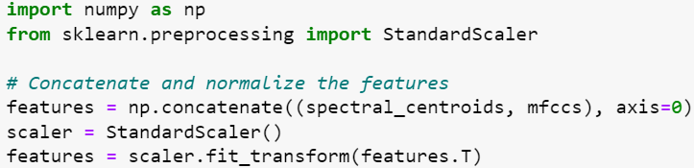
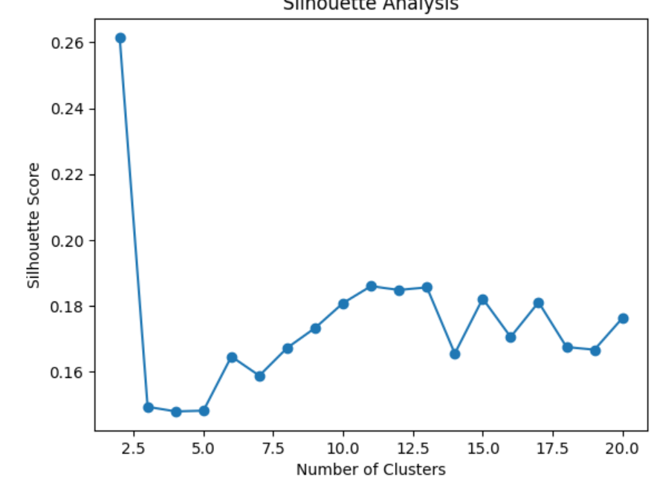
3. Audio Process & clustering
3. Preprocess audio features: concatenate and normalization
4. Apply clustering

Slide 12
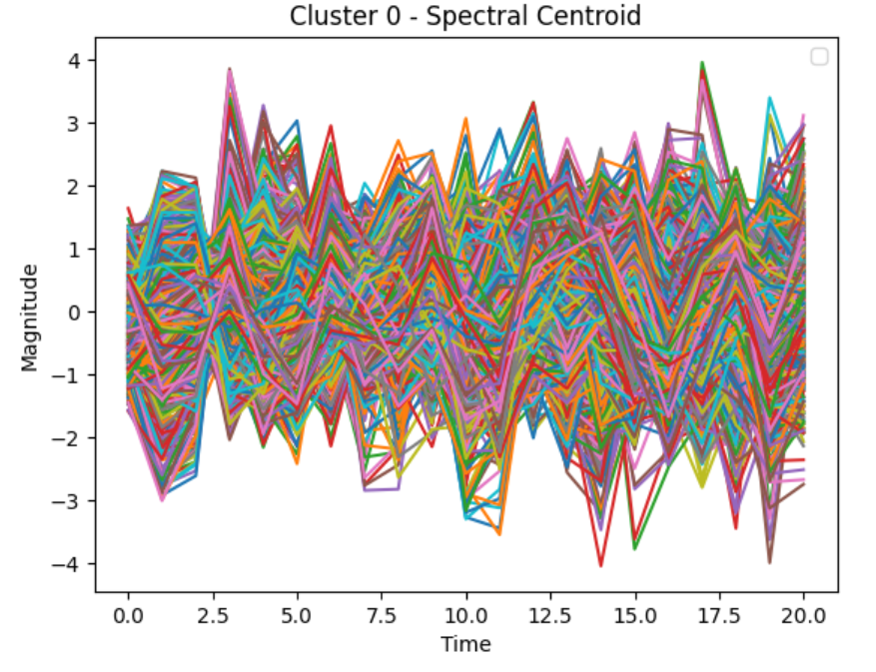
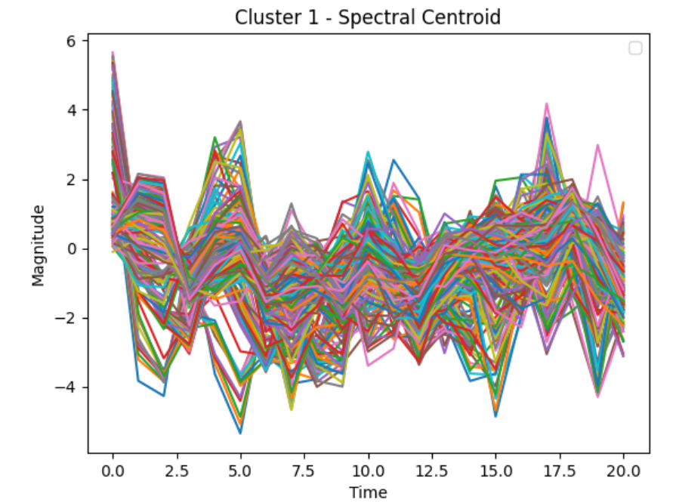
3. Audio Process & clustering
5. Analyze clustering results
6. Next steps:input all segmented audio files and iterate through them and add more audio features like roll-off (for ultrasounds yo provided information about content distribution and frequency of the signal)

